Slide 1

KYC & Client Onboarding Data Quality Audit
Amal S

Slide 2
Agenda
1
2
3
4
5
Introduction
Primary Goals
KYC Data Risk Overview
Strategic Roadmap for KYC Data Integrity
Summary

Slide 3

Introduction
Know Your Customer(KYC) compliance is a core requirement in banking and financial services. Ensuring accurate and complete client data helps institutions prevent fraud, meet regulatory obligations, and improve operational efficiency.
This project simulates a real-world scenario of client onboarding, where incomplete or inconsistent data can trigger compliance risks.
Using Python, I created synthetic client records and implemented logic to detect missing values, data entry errors, and sanctioned country flags.
The project also includes fuzzy matching techniques to correct misspelled country names — a common issue in data entry.
Visual summaries of flagged issues provide actionable insights for improving KYC data quality and onboarding workflows.

Slide 4

Primary goals
Ensure completeness, accuracy, and compliance of client onboarding data using Python-based validation and flagging logic.

Slide 5
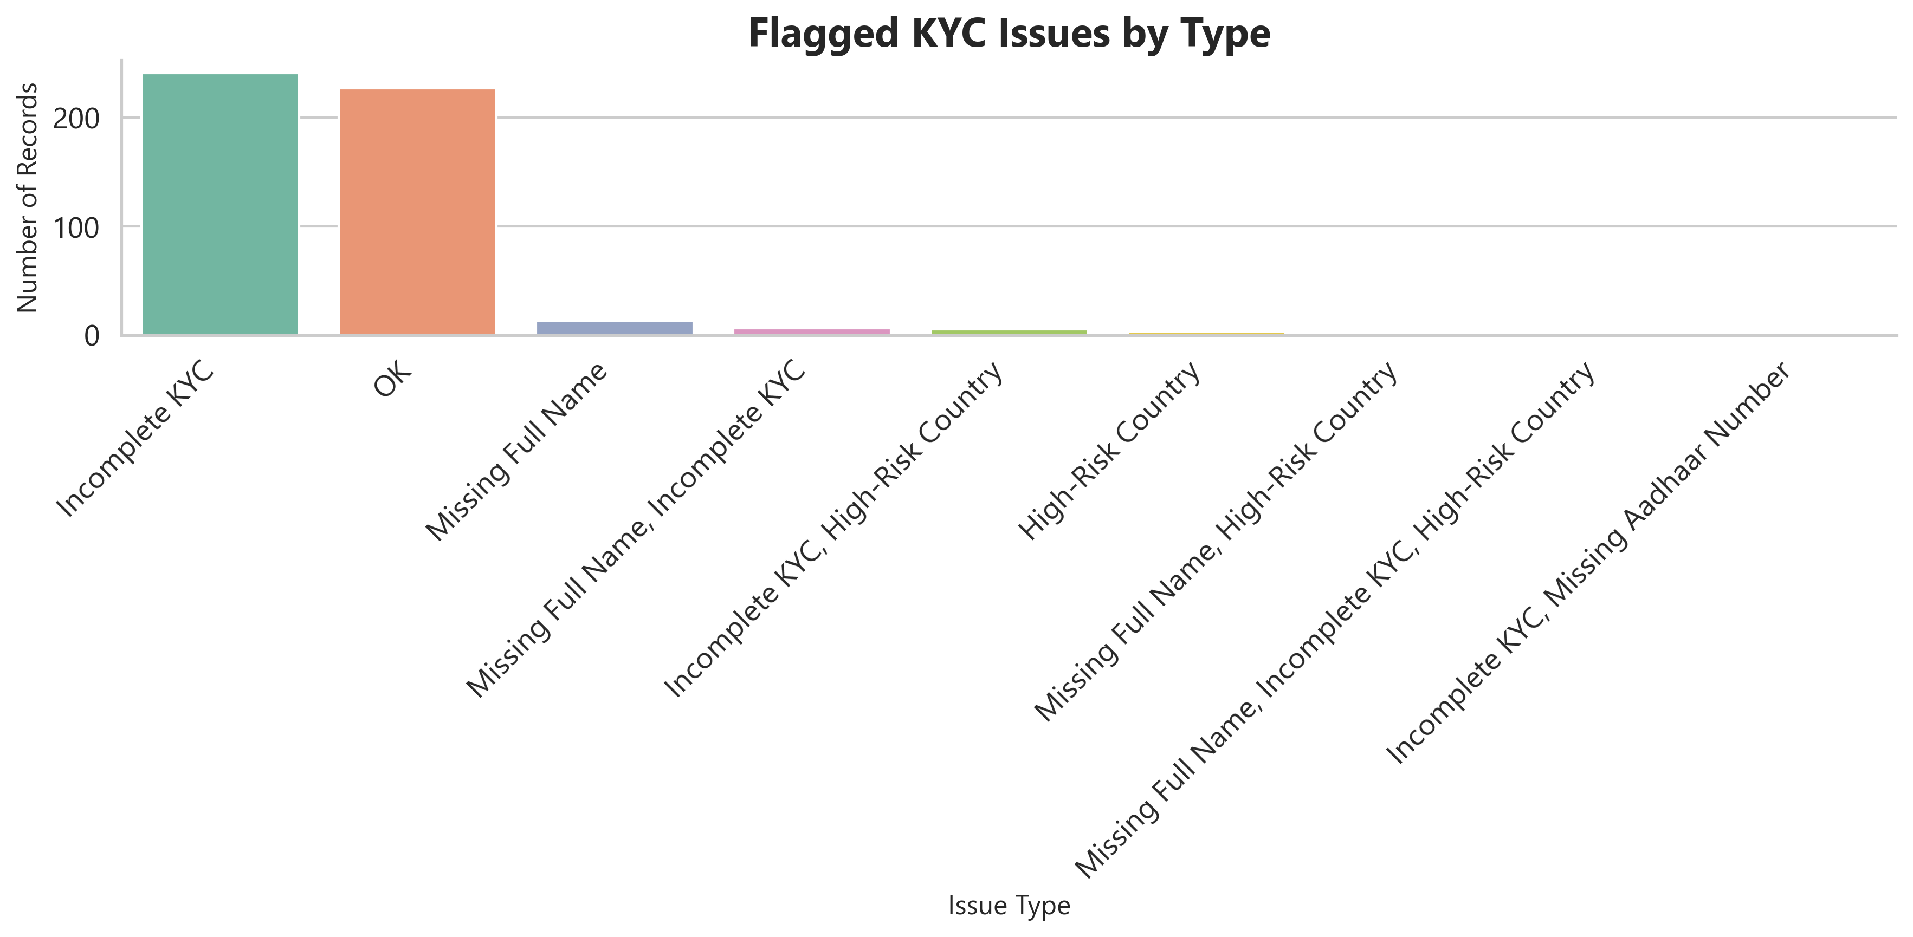
Flagged KYC Issues by Type

Slide 6
KYC Data Risk Overview
Issue Type | Number of Records | Risk Level | Suggested Action
Incomplete KYC | 241 | 🔴 High | Improve follow-up and automate document reminders
Missing Full Name | 13 | 🟡 Moderate | Make full name mandatory at entry point
Missing Full Name, Incomplete KYC | 6 | 🔴 High | Flag for manual review before account activation
Incomplete KYC, High-Risk Country | 5 | 🔴 High | Escalate for compliance officer review
High-Risk Country | 3 | 🔴 High | Block or require enhanced due diligence (EDD)
Missing Full Name, High-Risk Country | 2 | 🟠 Medium | Cross-check with source documents
Missing Full Name, Incomplete KYC, High-Risk Country | 2 | 🔴 Critical | Multi-risk: escalate immediately
Incomplete KYC, Missing Aadhaar Number | 1 | 🔴 High | Indian client: Aadhaar should be required
OK (No issues) | 227 | 🟢Low | No action needed

Slide 7
Without data, you're just another person with an opinion
“
”
W. Edwards Deming

Slide 8
Tools & Technologies Used
Tool/Tech | Purpose
Python (pandas) | Data cleaning, simulation
Faker | Generate synthetic client data
RapidFuzz | Correct misspelled country names
Matplotlib/seaborn | Visualizations
PowerPoint | Final reporting & presentation

Slide 9
Key Takeaways / Lessons Learned
Real-world KYC processes can have hidden data quality issues
Simple Python tools can help detect compliance risks at scale
Fuzzy matching and rule logic are powerful for automated anomaly detection
This project strengthened my confidence in data-driven decision-making
9
KYC Data Analysis
2025

Slide 10





Strategic Roadmap for KYC Data Integrity
Planning
Define Key Fields & Flags
Validation
Build Validation & Simulation
Cleaning
Data Correction & Enrichment
Analysis
Detect Patterns & Risks
Reporting
Deliver Insightful Outcomes

Slide 11
Strategic Priorities in KYC Data Quality
KYC Data Integrity & Automation
Develop logic to detect incomplete or non-compliant KYC entries
Automate anomaly detection using synthetic datasets
Clean and standardize messy inputs (e.g., country misspellings)
Visualize risk concentrations across account types
Scalable Risk Flagging Framework
Extend rule-based detection to real-time onboarding systems
Integrate fuzzy matching with live data validation pipelines
Enable proactive compliance alerts to avoid future fines
Build dashboards (Power BI or internal tools) for compliance teams

Slide 12
How we got there​
Data Generation & Preparation
Validation & Flagging Logic
Insight Delivery & Reporting
“Laying the foundation with synthetic data"
Generated realistic client onboarding data using Python & Faker
Simulated anomalies (e.g. missing fields, high-risk countries)
Structured dataset to reflect real-world KYC scenarios
​
“Applying rules to find risk and gaps"
Created rule-based logic to flag incomplete or suspicious data
Used fuzzy matching (RapidFuzz) to fix country spelling errors
Identified patterns in risk by account type (Retail, HNI, Corporate)
“Turning data into actionable insights"
Visualized issues using bar charts & summary tables
Presented findings in a professional PowerPoint report
Suggested real-world actions (e.g. Aadhaar enforcement, alerts)

Slide 13

Summary
In this project, I simulated and audited KYC onboarding data to identify compliance risks and data quality issues.
Using Python and rule-based logic, I flagged incomplete records, corrected country misspellings with fuzzy matching, and visualized risk patterns across account types.
This hands-on approach helped me understand the real-world importance of data accuracy in financial onboarding systems — and how even small errors can have regulatory consequences.
I believe clean, validated data is the foundation of trust in any client-facing organization.

Slide 14

Thank you
Amal S
amal17ek@gmail.com
linkedin.com/in/amal-s-9a5b86310

